Slide 1

Introduction to PyTorch

Slide 2
What is PyTorch?
Open-source deep learning framework developed by Facebook’s AI Research lab (FAIR)
Primarily Python-based, with C++ back-end for performance
Widely used in deep learning, computer vision, NLP, and reinforcement learning
Designed for ease of use, flexibility, and fast prototyping
https://docs.pytorch.org/docs/stable/index.html

Slide 3
Key features of PyTorch
Reverse-mode auto-differentiation (via torch.autograd):
  Efficient gradient computation for backpropagation
  Eliminates manual derivative calculations
GPU acceleration with CUDA:
  Easy switching between CPU & GPU tensors together with NVIDIA GPU
Rich ecosystem:
  TorchVision, TorchText, TorchAudio for domain-specific tasks
  PyTorch Lightning, HuggingFace Transformers…

Slide 4
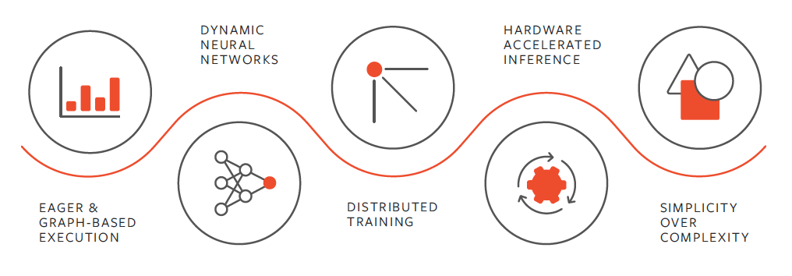
Figure: https://www.nvidia.com/en-gb/glossary/pytorch/

Slide 5
Tensors
A tensor is the basic object PyTorch uses to store data and perform computations.
Everything the model sees — inputs, outputs, weights — is a tensor.
A tensor is a generalisation of arrays
Think of it as a box of numbers with a shape
Why tensors matter:
Models only operate on tensors, not raw data
Tensors can live on CPU or GPU
PyTorch tracks tensor operations for automatic differentiation
Convert from numpy to tensor:
x_tensor = torch.from_numpy(x_np)

Slide 6
CPU vs GPU
CPU = central processing unit; GPU = graphics processing unit
CPUs are good at many different tasks
GPUs are good at doing the same maths many times in parallel
Deep learning = lots of matrix operations → GPUs are faster
GPUs can make training much faster
Code looks almost the same for CPU and GPU
You must move data and models to the same device
GPU pioneered by NVIDIA for graphics (gaming) – applied now to AI for speed

Slide 7
PyTorch pipeline

Slide 8
Setup
Prepare the environment and core components needed to build and run a PyTorch model.
Import PyTorch and supporting libraries (e.g. torch, torch.nn, torch.optim)
Check CUDA availability (GPU or no GPU?)
Set device: CPU vs GPU with torch.device
Fix random seeds for reproducibility

Slide 9
Data and Data Loaders
Teach PyTorch how to access your data and how to feed it to the model in small, manageable chunks.
This step bridges the gap between raw data (files, tables, images, text) and the training loop.
Start with raw data (e.g. CSV files, images, text)
Apply basic preprocessing (cleaning, normalisation, encoding)
Create a Dataset object that:
  Knows how many samples exist
  Knows how to return one sample at a time
Use a DataLoader to:
  Combine samples into batches
  Shuffle data during training
  Load data efficiently while the model runs
Iterate over the DataLoader inside the training loop

Slide 10
Model
The model is a learnable function that maps input tensors to predictions.
The model takes tensor batches from the DataLoader and produces predictions.
Define model or use pretrained model
  Neural network, MLP, LLMs, CNNs, GNNs…
Send model to device (CUDA or CPU)

Slide 11
Loss and Optimisation
Measure how wrong the model’s predictions are (loss) and update the model to improve them (optimisation)
Loss = a single number that tells us how bad the predictions are
Optimisation = the process of adjusting model weights to reduce the loss
Implementation
Choose a loss function (e.g. MSE, Cross-Entropy) – depends on the prediction type
Initialise an optimizer (e.g. SGD, Adam)
Compute loss from model predictions and true labels
Use loss.backward() to compute gradients
Call optimizer.step() to update weights
Reset gradients with optimizer.zero_grad()

Slide 12
Train – validation – test
Training data teaches the model
Validation data helps tune decisions (e.g. model choice, hyperparameters)
  Used during development
  Helps detect overfitting
  Guides model and hyperparameter selection
Test data gives the final, unbiased performance estimate
  Used once, at the very end
  Never influences training decisions
  Represents real-world performance

Slide 13
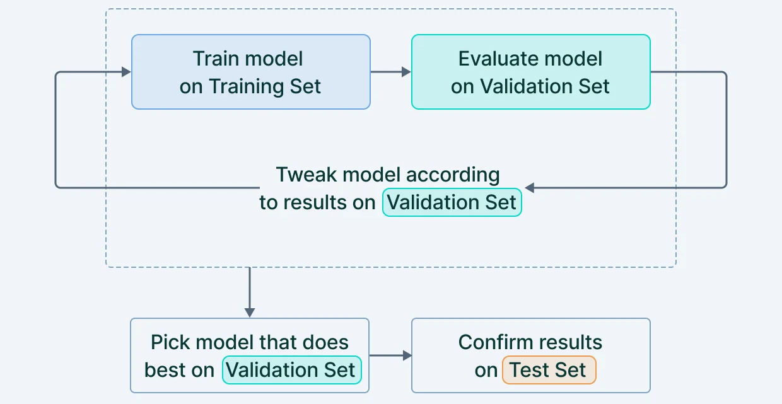
Train – validation – test
https://www.v7labs.com/blog/train-validation-test-set

Slide 14
Train loop
Repeatedly show the model data, measure its mistakes, and update its parameters so it learns over time. This is when the model is learning!
Data is split into small batches (not all at once)
Each batch gives a partial learning signal
Information from many batches is accumulated across updates
Weight updates accumulate knowledge from all batches
One full pass over all batches = one epoch
Implementation
model.train()
Loop over epochs
Loop over batches from the DataLoader
Forward pass on one batch
Compute batch loss
Backpropagate gradients
Update shared model parameters
Repeat for all batches

Slide 15
Validation and Test
Check how well the model generalises to unseen data, not data it was trained on.
Validation data: keep training model after validation evaluation to learn from mistakes → avoid overfitting
Test data gives the final, unbiased performance estimate
Switch model to evaluation mode: model.eval()
Disable gradients with torch.no_grad()
Loop over validation/test DataLoader
Compute loss and metrics
Aggregate results across batches

Slide 16
Common mistakes to watch out for!
Forgetting to call model.train() / model.eval()
Not using torch.no_grad() during evaluation
Mixing CPU and GPU tensors – everything needs to be on the same device!
Forgetting optimizer.zero_grad() before backpropagation
Using the test set during training or tuning
Mismatched tensor shapes (especially labels)
Assuming lower training loss means better generalisation

Slide 17
Additional links
PyTorch installation for future environments: https://pytorch.org/get-started/locally/
PyTorch documentation: https://docs.pytorch.org/docs/stable/index.html
PyTorch tutorials: https://docs.pytorch.org/tutorials/
Medium introduction to PyTorch: https://medium.com/@rtdcunha/a-beginners-guide-to-pytorch-6bc600ca4b8d
Cheat sheet: https://www.mad.tf.fau.de/files/2019/07/pytorch-cheatsheet-en.pdf

